Slide 1
Design Shell

Slide 2
Project Description
Create a reusable CSS file that has styles for
All the headings
Paragraphs
Div tags
This CSS file should have classes that provide some layout for header, footer and main content

Slide 3
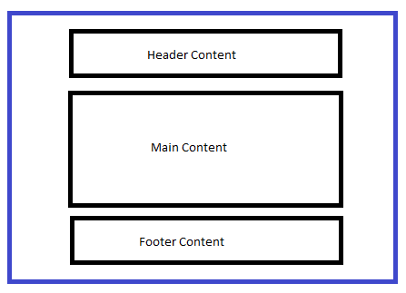
Project Description
You can take the below screenshot as a hint to specify the layouts in the CSS
Note: Below image is just an hint, you are free to specify the layout as per your wish.

Slide 4
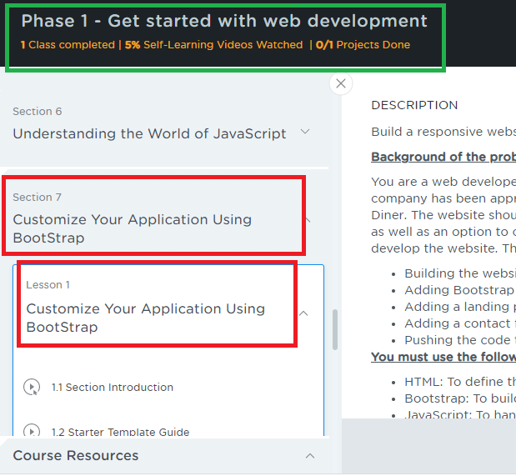
Project Submission Steps
Since there’s not separate place to submit the Design Shell, you will submit in Phase 1 -> Section 7 -> Lesson 1 -> 1.20
Since there’s no section end project in bootstrap you will submit design shell here.

Slide 5
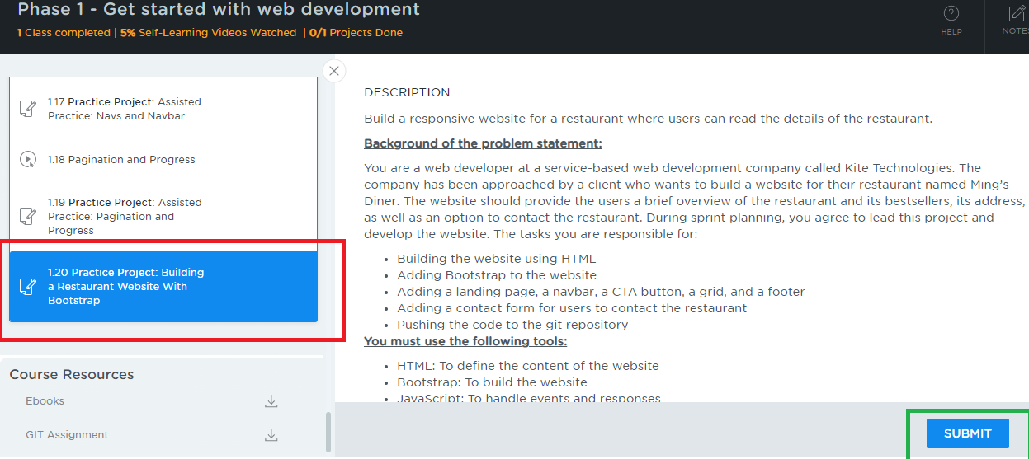
Project Submission Steps
Choose section 7, click lesson 1 and scroll down to the sub-section 1.20 which has a Practice Project – Build a Restaurant Website with Bootstrap, click on it you will see the description and submit button

Slide 6
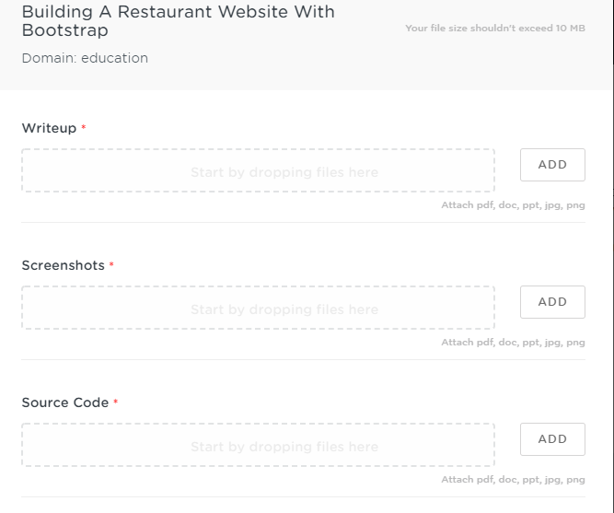
Project Submission Steps
After you click on submit you will get a window as below
Things to submit:
Writeup:
Upload a word document that will have the Git repository link so that from the LMS we can download this document to find your git repository
Give a brief explanation about your project and the files & folders we need to look into so that it is easy to locate.
Screenshots:
Upload the files that will have screenshots of the output
Source Code:
Upload the Zip files that will have all your source code files, if in case you face problem in attaching the zip, you can attach the source code files one by one
Additional Remarks:
Mention some remarks if required

